Slide 1
A compact high precision AC/DC DIGITAL AMMETER
4NM20EE003 | AKASH
4NM20EE009 | ANWESH R SHETTY
4NM20EE020 | DHANUSH
4NM20EE032 | KANZAL HAQ A

Slide 2
Aim
To design a AC/DC digital ammeter.

Slide 3
Introduction
Digital ammeter is a measuring instrument used to measure the current in a circuit and displays it on a digital display. The ammeter is usually connected in series with the circuit in which the current is to be measured. An ammeter usually has low resistance so that it does not cause a significant voltage drop in the circuit being measured.

Slide 4
Objectives
To design and build a Digital Ammeter which can be used to measure both AC and DC current
To have a wide range of measurements from a few hundred micro-Amperes to 10 Ampere
An Auto ranging function to adjust the output without having to manually set the range
To reduce the size of the device

Slide 5
Problem Definition
To build a digital ammeter capable of measuring current value of both AC and DC system.
Goal is to build a device which can measure current from 100uA to 10A.

Slide 6
Project Description
Hall current sensor – Applied current flowing through the low resistance copper conduction path generates a magnetic field which is sensed by the integrated Hall IC and converted into a proportional voltage.
Analog to Digital Converter – Converts the analog signal from the sensor to digital 16 bit signal.
Microcontroller – To interface ADC and LCD display.
LCD – 16x2 LCD to display measured current.

Slide 7
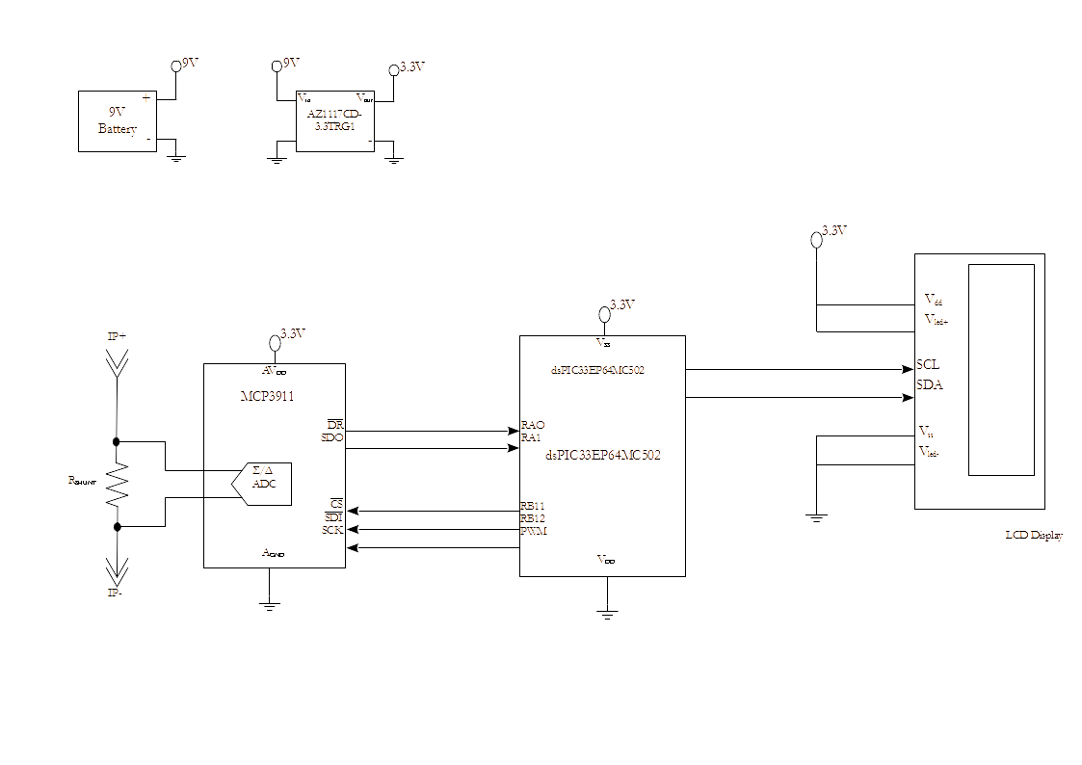
BLOCK DIAGRAM

Slide 8
References
P. Petrovic, "New digital multimeter for accurate measurement of synchronously sampled AC signals," in IEEE Transactions on Instrumentation and Measurement, vol. 53, no. 3, pp. 716-725, June 2004, doi: 10.1109/TIM.2004.827313.
L. Sevgi, " Digital Multi-Meters and Basic Measurements," in IEEE Antennas and Propagation Magazine, vol. 49, no. 4, pp. 232-237, Aug. 2007, doi: 10.1109/MAP.2007.4385653.
Datasheet of Hall Effect sensor (ACS712)
Datasheet of PIC Microcontroller (PIC24F04KA201)

Slide 9
Thank You

